Slide 1
Testing using Jasmine and Karma – Step 10

Slide 2
Testing
Testing is use to find the defect or bugs or error in the application.
Tests are the best way to prevent software defects.
There are two types of testing
Black box testing : Black box testing involves testing a system with no prior knowledge of its internal workings.
White box testing : White box testing techniques analyze the internal structures the used data structures, internal design, code structure

Slide 3
Unit testing
Unit testing is a software development process in which the smallest testable parts of an application, called units
Unit Testing is a type of software testing where individual units or components of a software are tested.

Slide 4
Jasmine
Jasmine is an open-source and most popular JavaScript library testing framework to test any kind of JavaScript application.
Jasmine is a behavior-driven development framework for testing JavaScript code
Jasmine provided test suite, test case and assertion to test plain JavaScript code or JavaScript library or framework.

Slide 5
Karma
Karma is test runner for testing framework.
Karma is essentially a tool which spawns a web server that executes source code against test code for each of the browsers connected.
he results of each test against each browser are examined and displayed via the command line to the developer such that they can see which browsers and tests passed or failed.

Slide 6
Testing plain JavaScript function
First we need to download jasmine configuration details.
Jasmine official website provide sample jasmine configuration details which we can download from the below git.
https://github.com/jasmine/jasmine/releases
Open downloaded sample project from git.
Extract this project and write simple JavaScript function to test the code using jasmine.

Slide 7
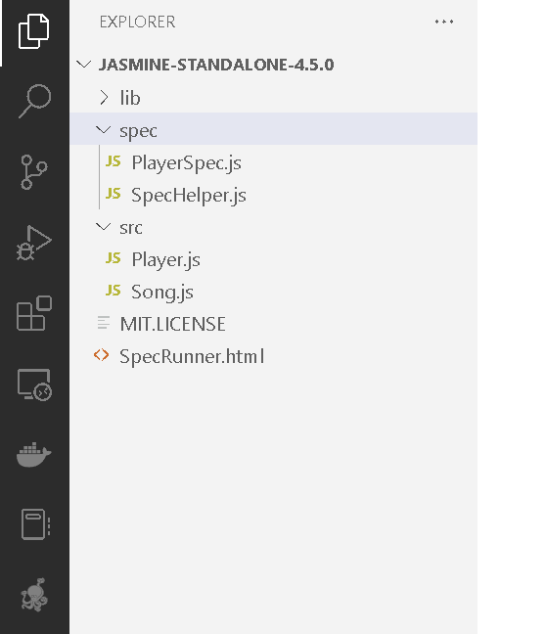
Jasmine sample project structure

Slide 8
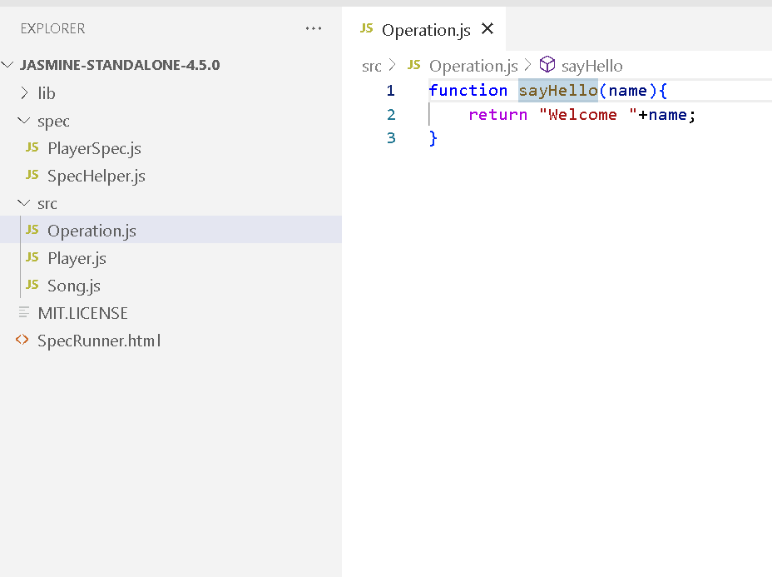
Now create sample js file with simple function

Slide 9
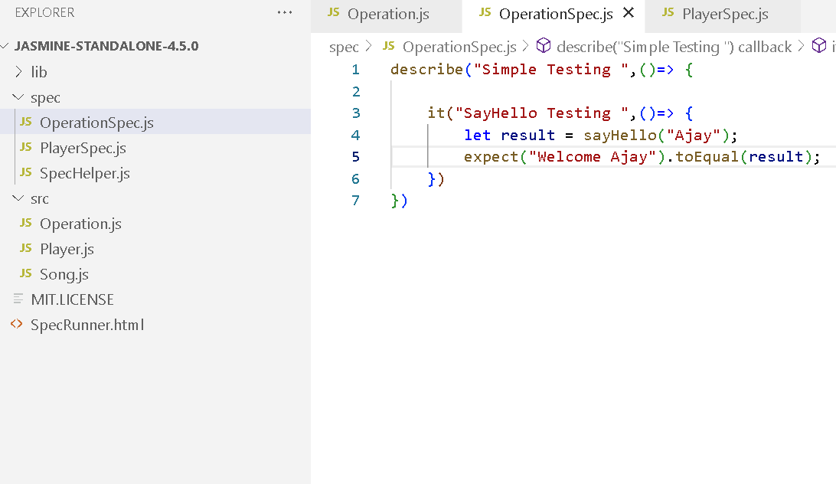
Sample test case

Slide 10
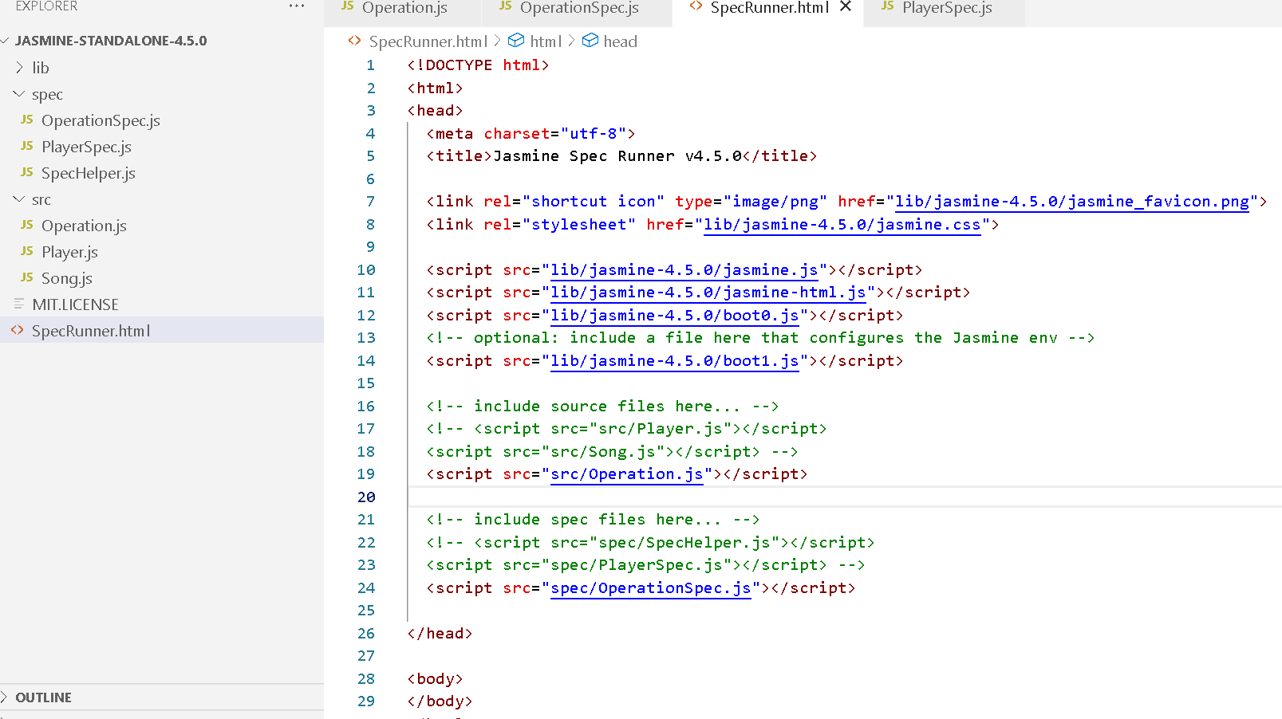
Now include both pages in SpecRunner.html page

Slide 11
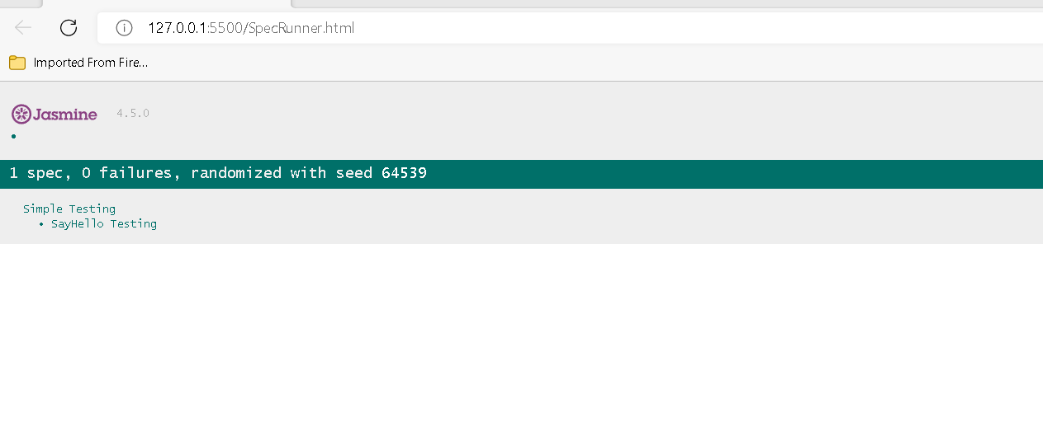
Running SpecRunner.html page

Slide 12
Testing with angular framework
Angular internally use jasmine testing framework to test angular component, service, model classes.
Angular provided all configuration details when we download all dependencies.
Angular use karma test runner tool to check result.
Angular provided testing utilities classes to check angular component, service and model etc.

Slide 13
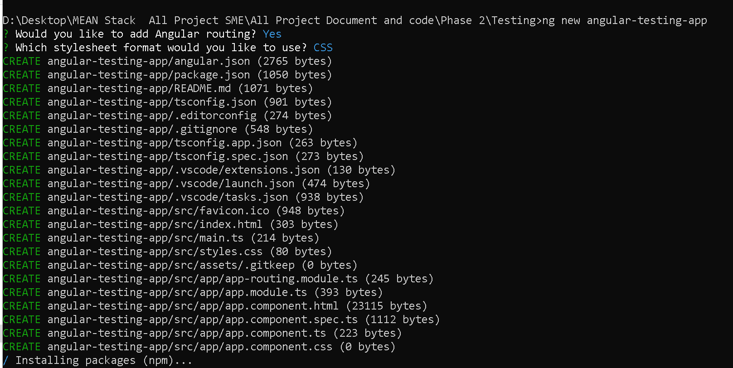
Create the project as normal angular project

Slide 14
Sample testing file present in angular project
src→app→app.component.spec.ts
This file contains sample test case

Slide 15
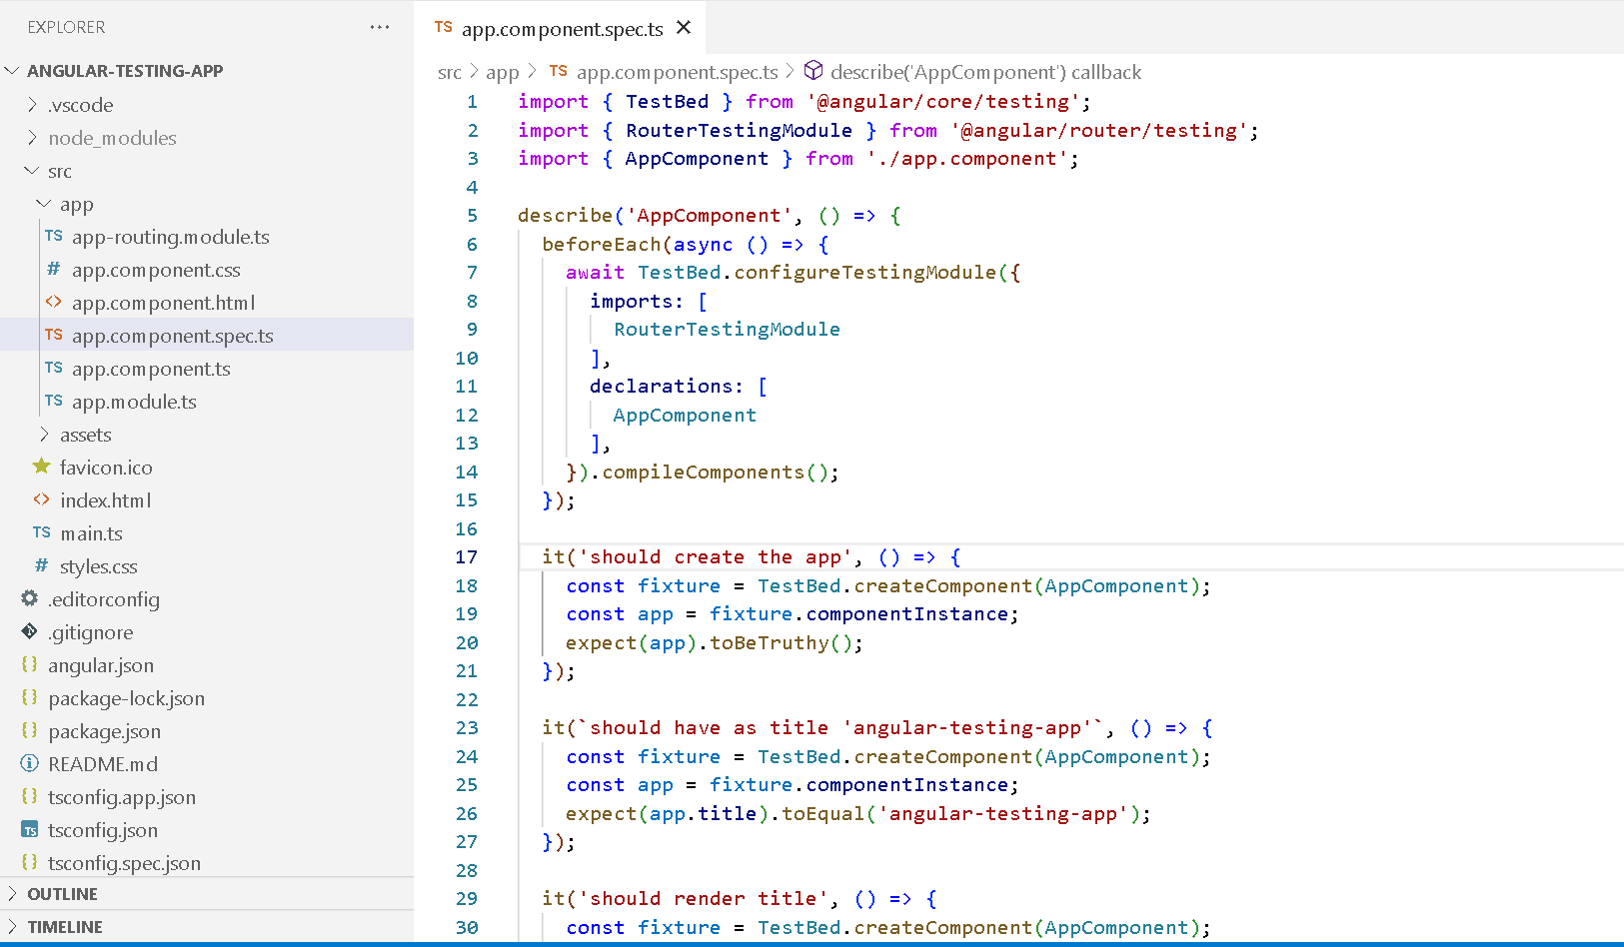

Slide 16
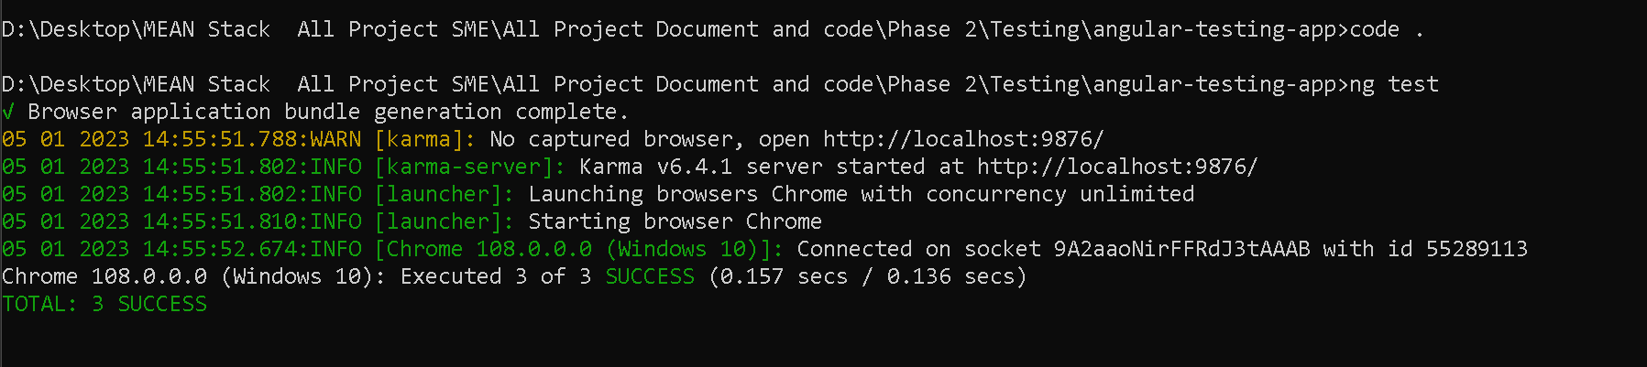
To run the test case
We need to use the command as
ng test

Slide 17
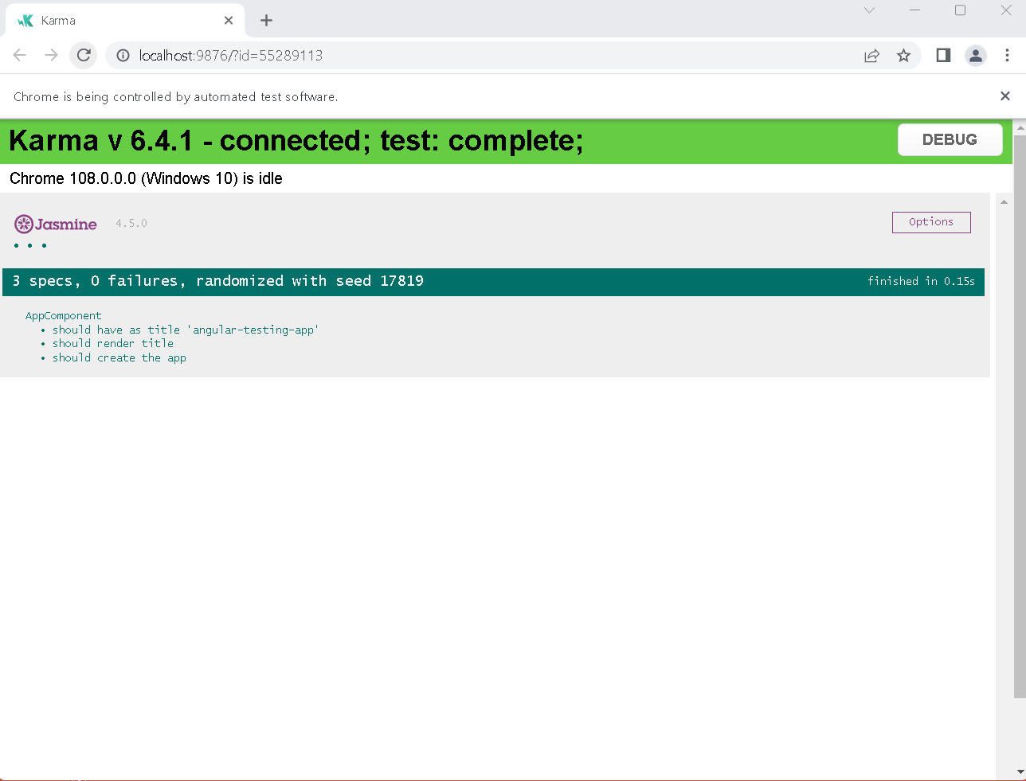

Slide 18
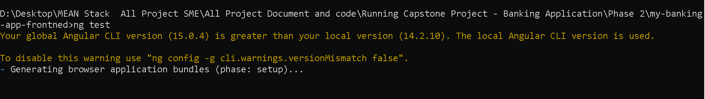
Testing in banking application

Slide 19
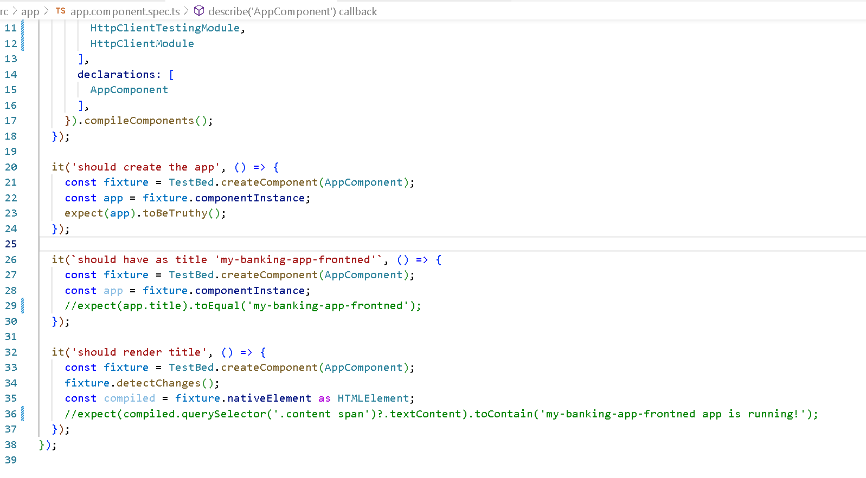
app.component.spec.ts

Slide 20
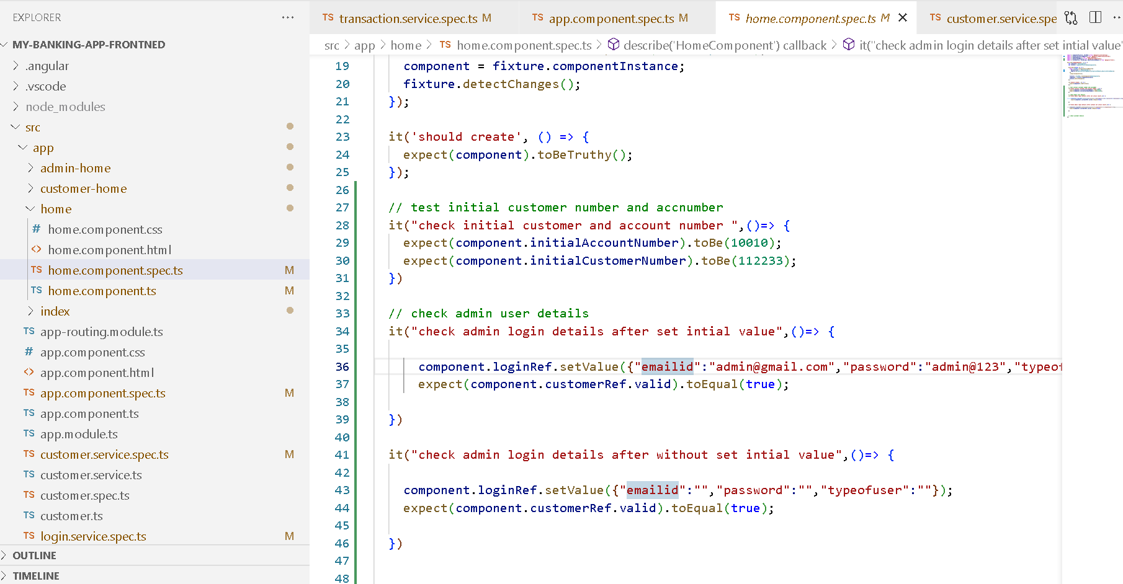
Home.component.spec.ts

Slide 21
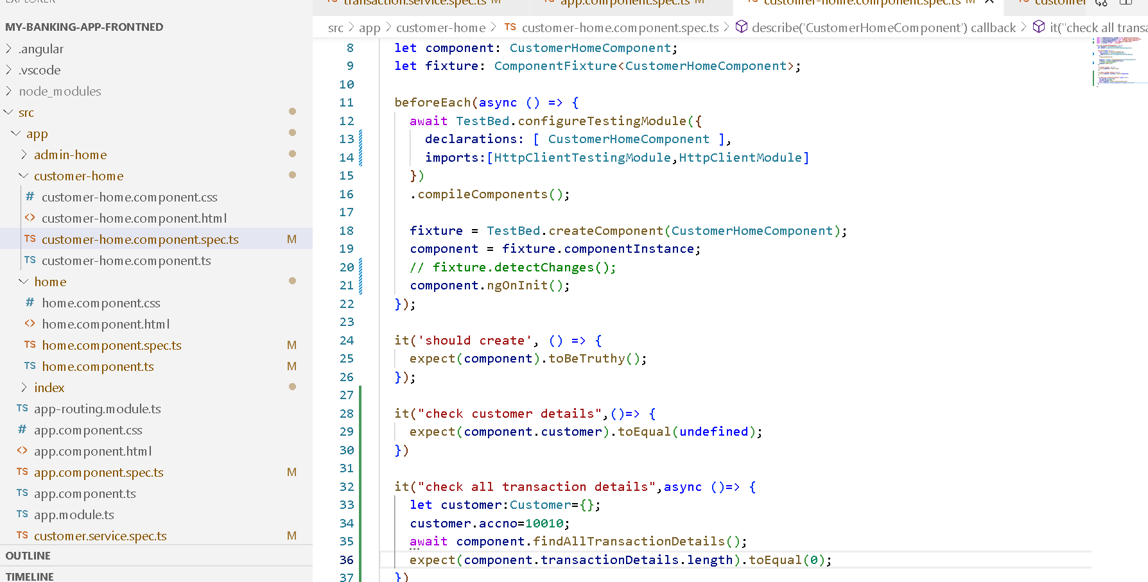
Customer-home.component.spec.ts

Slide 22
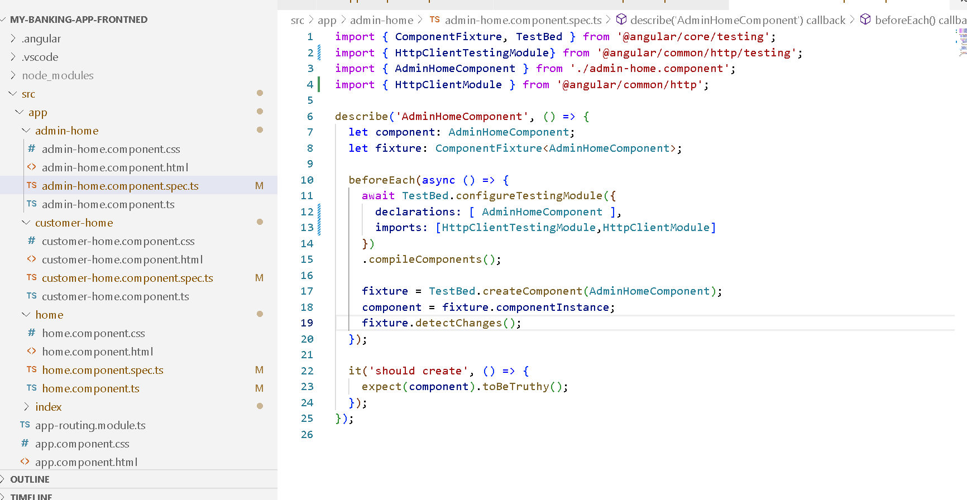
Admin-home.component.spec.ts

Slide 23
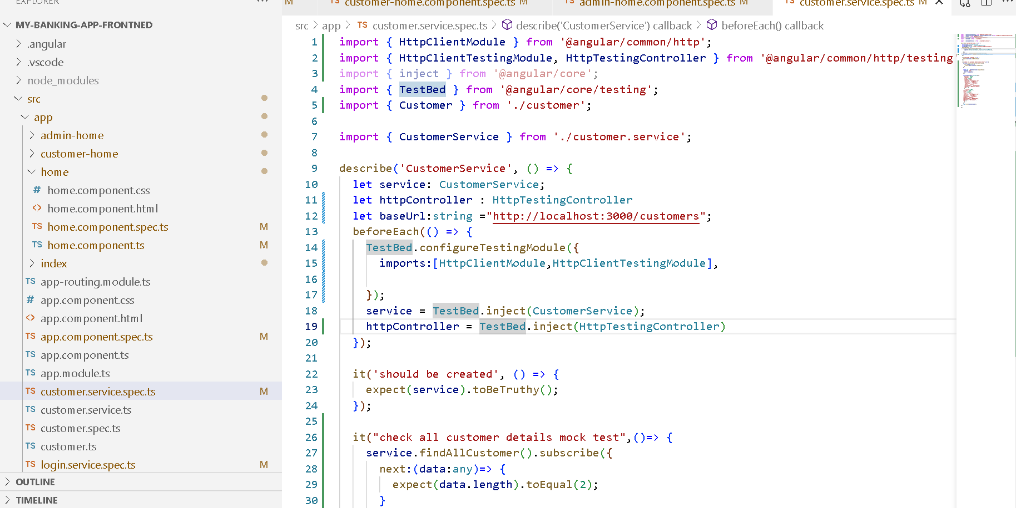
Customer.service.spec.ts

Slide 24
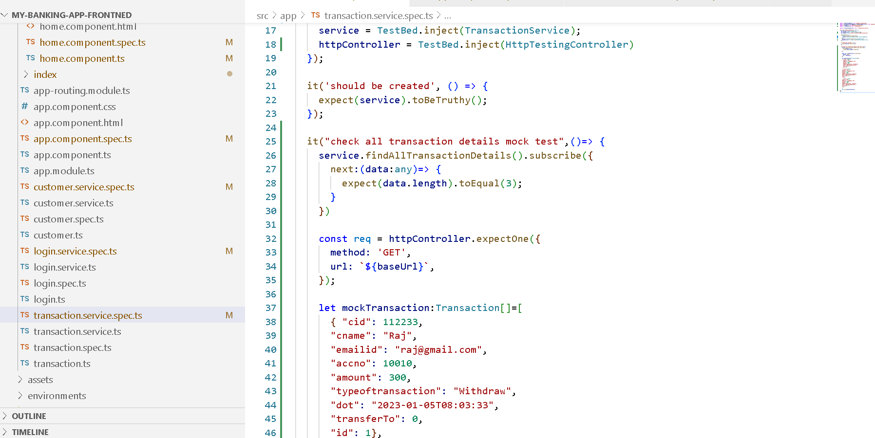
Transaction.service.spec.ts

Slide 25
